Slide 1
Outbound Integrations for API platform
aka communicating system events to partners

Slide 2
Scenario
Insurance provider wants to share customer events, with partner organisations. e.g. policy purchased, activated, refunded, etc.
This will enable multiple business scenarios like referral, white labelling, etc.

Slide 3
Options?
Polling
WebHooks
WebSub
WebTask

Slide 4


Polling
Insurer
Builds
and
Operates
Simple implementation
But,
Majority of poll requests are wasted
costly for insurer and partner to operate due to wasted calls
Insurer Core Business System
Insurer
API Platform
poll request
poll response
poll request
poll response
poll request
poll response
98.5% of
polls are wasted
Partner
System
Source
http://resthooks.org/

Slide 5

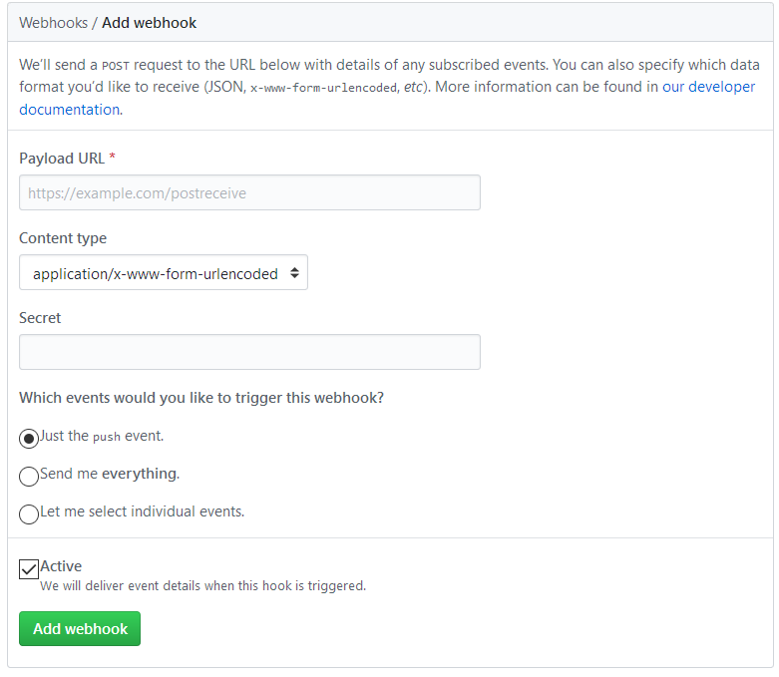
WebHooks, user-define HTTP call-backs
https://github.com/{...}/settings/hooks/new
better than polling
But,
costly for insurer to implement and operate (services, queues, protocol adaptors, etc.)
susceptible to DDOS (no subscription verification step)
Insurer
Builds
and
Operates
Insurer Core Business System
2 trigger webhook
Insurer
API Platform
Insurer WebHook Provider
1 subscribe
3 fire webhook
Partner Core
System
Partner
WebHook Consumer

Slide 6


WebSub, extension of WebHooks
Insurer
builds
and
operates
A HUB mediates between insurer and partner systems
Subscriptions are verified by hub by issuing a challenge to subscriber (partner) and expecting back a result with validation code
Events communicated in 2 modes
light ping – (3) insurer pushes event only, (5) partner subsequently pulls full data from insurer API
fat ping – (3) insurer pushes event with data
Insurer Core Business System
3 light/fat ping
Insurer
API Platform
Insurer
configures
and operates
5 optional
follow-up
API call
Insurer Hub
1
subscribe
2 verify
subscription
4 webhook fires
https://www.w3.org/TR/websub/
Partner Core
System
Partner
WebHook Consumer

Slide 7




WebTask, insurer hosts custom platform extension code provided by partners
Insurer
Builds
and
Operates
Insurer Core Business System
2 trigger webhook
This concept has been embraced by Auth0 for extending their platform
Insurer
API Platform
Insurer WebHook Provider
https://webtask.io/
Insurer
Hosts
and
Operates
Partner provided
custom code for extending insurer platform
https://auth0.com/
Code could be polling, webhook consumer, or anything else that partner requires
Partner Core
System

Slide 8
Event Notifications
Using Azure Event Grid and WebHooks

Slide 9
Abstract Flow
Subscriber
(Partner)
Publisher
(Insurer)
Hub
(Insurer)
1a - partner driven subscription
Subscriber discovers hub advertised by publisher’s topic
Subscriber makes a POST to hub to subscribe to updates about topic
Hub verifies subscription attempt via a POST, expects validation code to be echoed back
1b – insurer driven subscription
Subscription created on-behalf
of subscriber
2 – event notification
Publisher notifies hub of new content for the topic (events)
Hub delivers contents of topic (events with some payload) to subscriber, with links to get further details if required
3 – query (optional)
Subscriber queries updated data as indicated by event

Slide 10
WebSub-“like” implementation in Azure
Azure Event Grid with WebHook subscription – conforms to several aspects of the WebSub specification.
Discovery endpoint is a missing aspect. Required only for enabling subscriber driven subscription process (1a in protocol flow)

Slide 11

Demo Application (steps 1b and 2)
Insurer Client App
Partner-A APIs
distinct notification operations
Insurer HUB
route events to subscribers
sub filter = “Partner-A”
/api/TransactionApproved
/api/TransactionUpdated
/api/TransactionPartialRefund
/api/TransactionRefund
Insurer API
policy transactions
Topic – Become A Member
Event Type - Purchase.Created
Event Type - Purchase.Fulfilled
push events
to hub topics
drive policy lifecycle
Created
Fulfilled
Partial
Refund
Refunded
Topic – Resolve My Complaint
Event Type - Purchase.PartialRefund
Partner-B API
single notification operation
/api/TransactionChanged
sub filter = “Partner-B”
Topic – Cancel My Membership
Event Type - Purchase.Refunded

